Slide 1

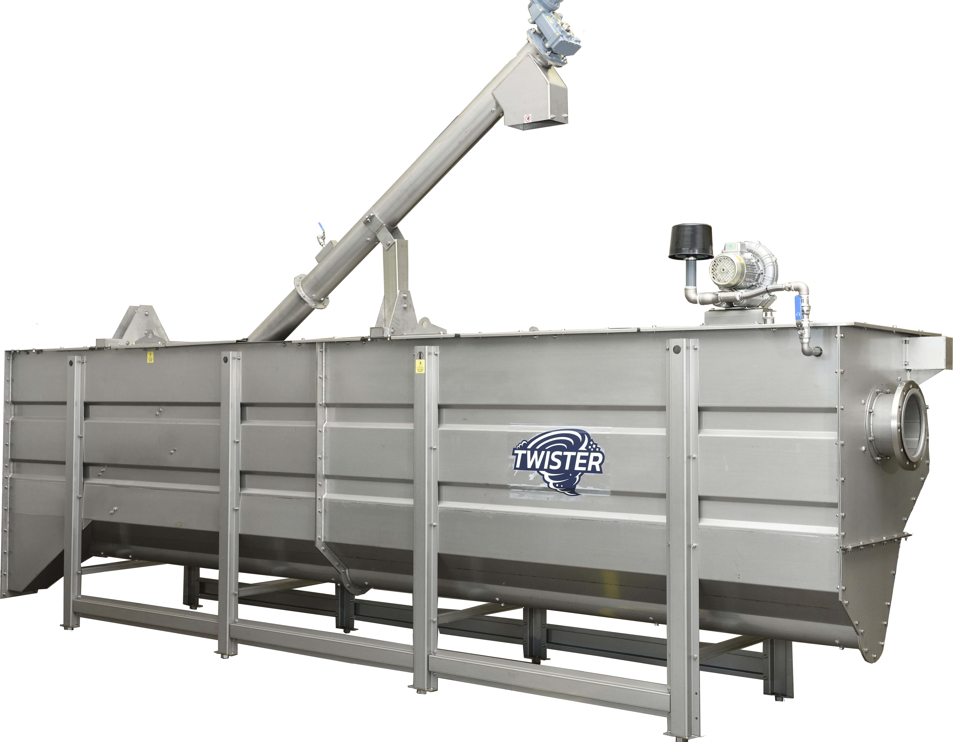
SEDITANK
Grit Removal
Food Waste
Process Equipment
Develop
Design
machines for solids recovery, liquid clarification, and minimize water consumption.
Deliver
project specific solutions for better economic, and environmental process performance.
process solutions partnerships to find efficiencies on new or existing process.
DRYCAKE
projects@drycake.com

Slide 2

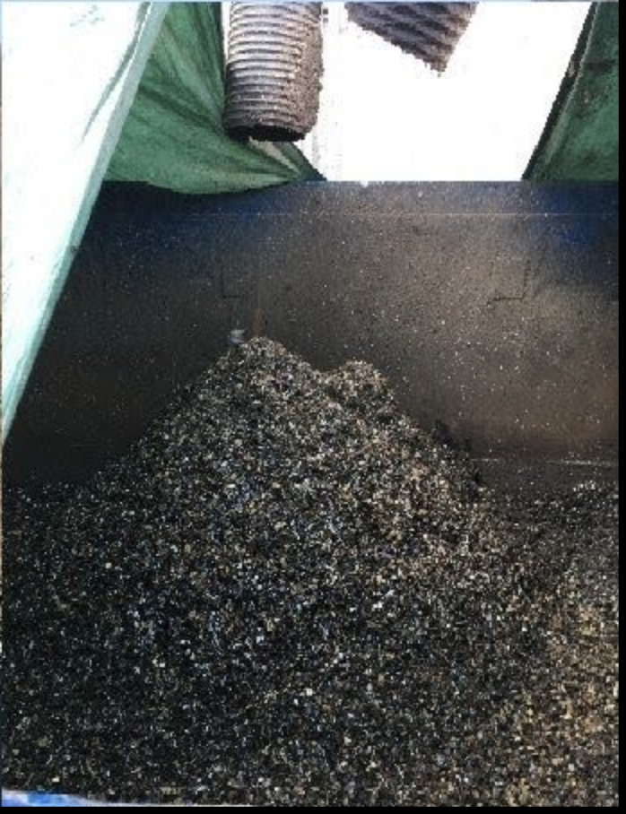
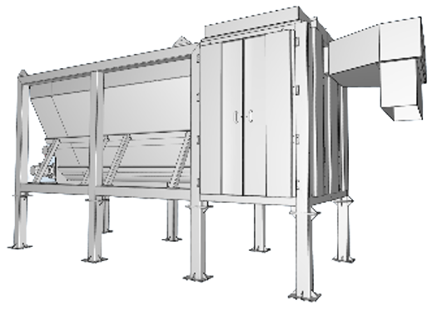
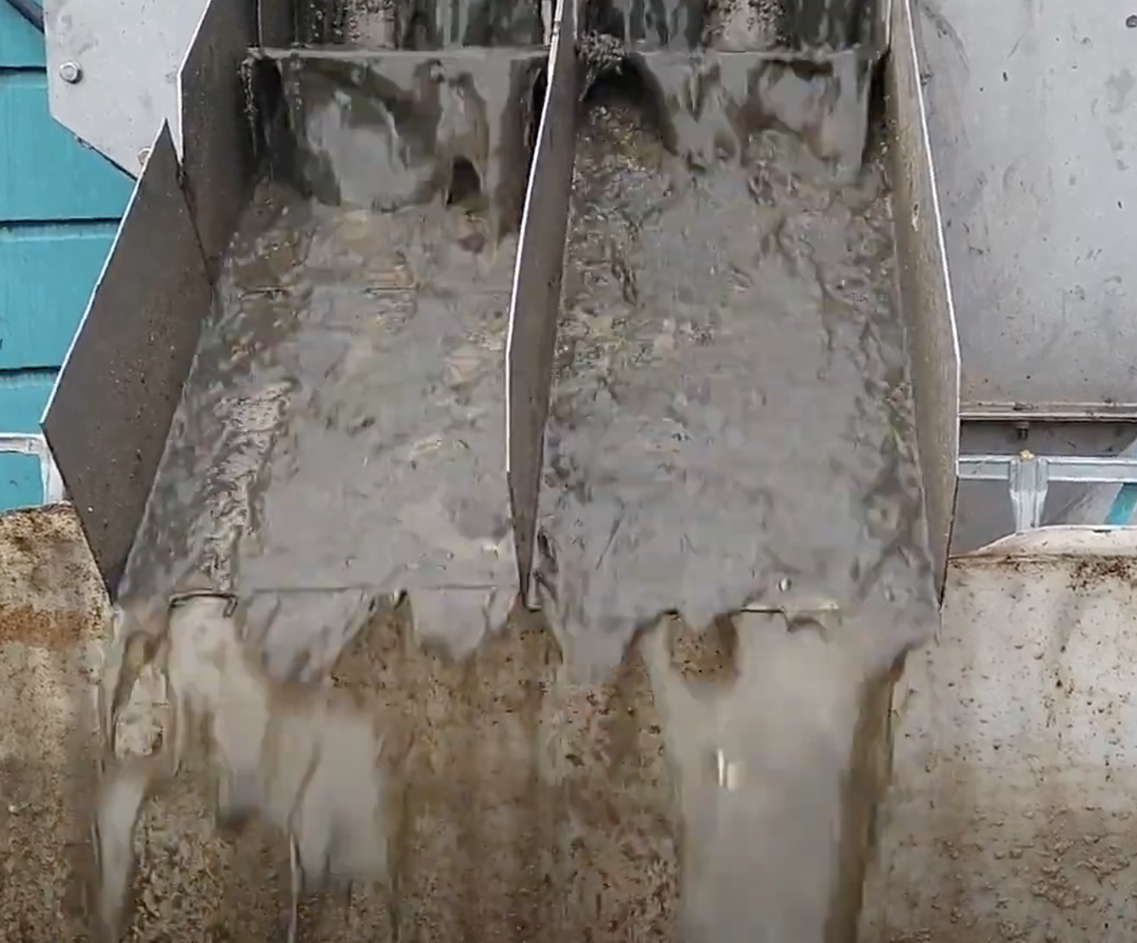
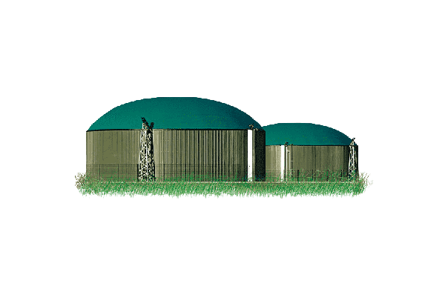
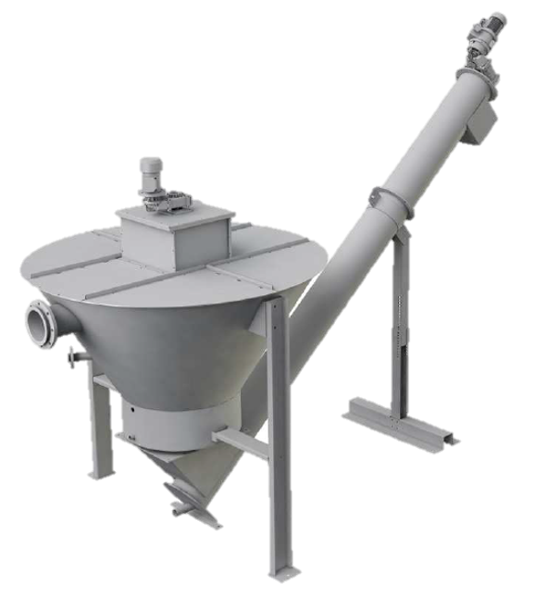
SEDITANK
Grit Removal
Post Depackager Grit Removal
The grit, heavy inert fraction, exits Depackagers with the organics outlet. The grit represents an important maintenance cost for Biogas Reactors, and is undesirable in the final digestate.
The Seditank removes the grit prior to entering the Biogas Reactors.
Organic Outlet
Separated Grit
Depackager Organic Outlet
SEDIWASH
As a second step, a Sediwash can be used to further recover organic matter. By washing the grit, the final weight of the grit can be reduced by 60% and the gas yield can be increased by 1%.
Furthermore, as the separated grit is drier it can assist in the liquid balance of the plant
DRYCAKE
projects@drycake.com

Slide 3
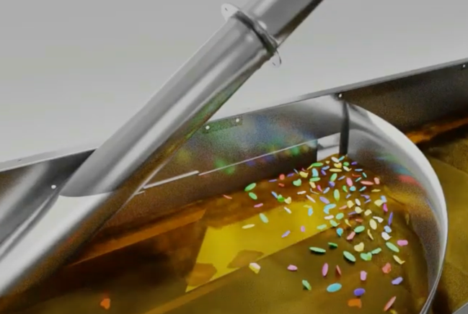
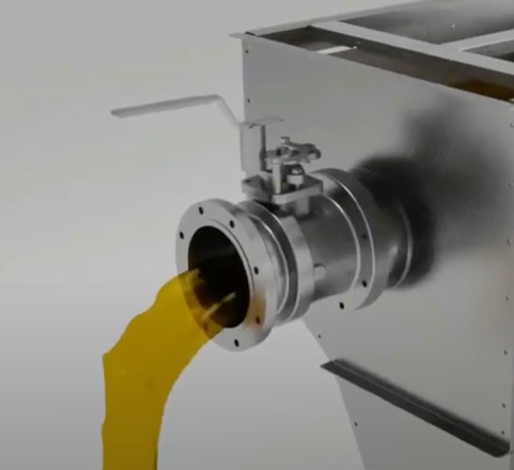
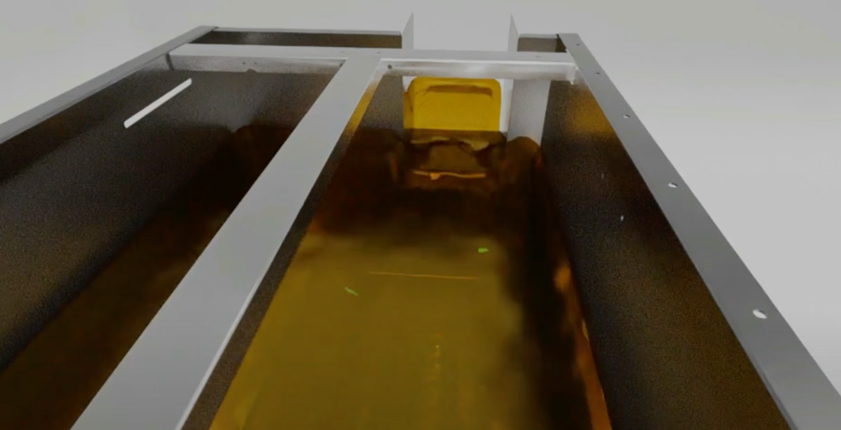
SEDITANK
Plastifloat
Plastifloat
The Seditank can optionally equipped with a, patent pending, Plastifloat system that removes residual plastics from the Depackager organics
The Floatate is removed by an adjustable valve and baffle plate and the clean liquid exits the unit by gravity into a buffer tank to pump the organics into the digester. The solid baffle plate by design retains all plastics including the microplastics.
The Floatate containing the plastics is processed by a small Twister designed with a special mesh to recover the plastics and homogenize the organic scum. The Organics is then re-introduced into the Seditank-Plastifloat. Plastics even recovered in a high concentration are still mixed with some scum, which has a very high energy value.
The Floatate is introduced into the Twister while processing feed stock directly into the vortex, at a position where the wind speed is more than 20 miles per hour guarantees that even the microplastics will be separated from the organics and discharge from the packaging discharge on the top of the Twister unit.
DRYCAKE
projects@drycake.com

